Slide 1

ALGEBRAIC CURVES

Slide 2
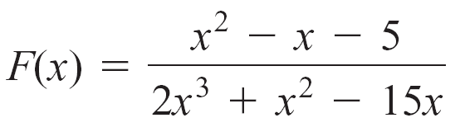
Vertical and Horizontal Asymptotes
If P(x) and Q(x) are polynomials, then the function F given by
is called a rational function. The domain of F is the set of all real numbers except those for which Q(x) = 0.
For example, let
Setting the denominator equal to zero, we have
2x³ + x² – 15x = 0

Slide 3
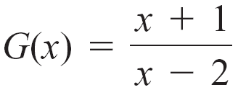
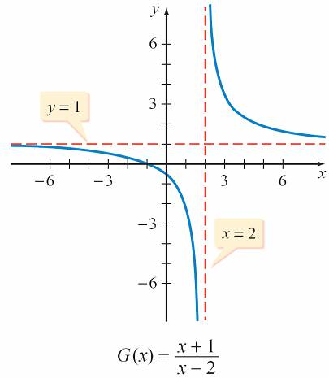
x(2x – 5)(x + 3) = 0
The denominator is 0 for x = 0, x = , and x = –3.
Thus the domain of F is the set of all real numbers except 0, , and –3.
The graph of is
given in the figure.

Slide 4
The graph shows that G has the following properties:
The graph has an x-intercept at (–1, 0) and a y-intercept at
The graph does not exist when x = 2.

Slide 5
When we are discussing functional values that increase or decrease without bound, it is convenient to use mathematical notation. The notation
as
means that the functional values f (x) increase without bound as x approaches a from the right.

Slide 6

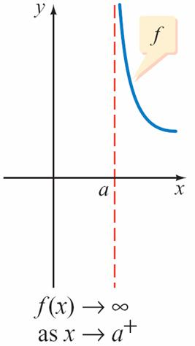
Recall that the symbol does not represent a real number but is used merely to describe the concept of a variable taking on larger and larger values without bound. See the figure below

Slide 7
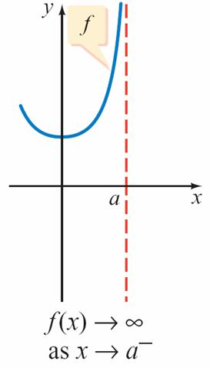
The notation
as
means that the function values f (x) increase without bound as x approaches a from the left. See the figure below.

Slide 8
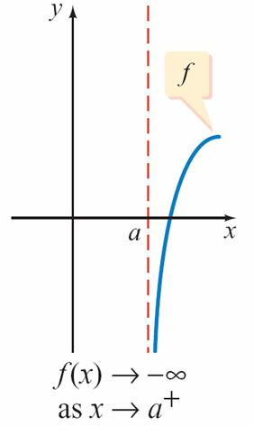
The notation
as x → a ⁺
means that the functional values f (x) decrease without bound as x approaches a from the right. See figure below.

Slide 9
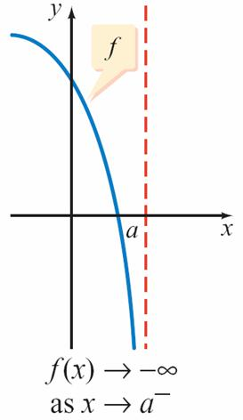
The notation
f (x) → as x → a –
means that the functional values f (x) decrease without bound as x approaches a from the left. See the figure below.

Slide 10
Each graph in the figure below approaches a vertical line through (a, 0) as x → a ⁺ or a –. The line is said to be a vertical asymptote of the graph.
(a)
(b)
(c)
(d)

Slide 11
Vertical and Horizontal Asymptotes
Definition of a Vertical Asymptote
The line x = a is a vertical asymptote of the graph of a function F provided
F(x) → + or F(x) →
as x approaches a from either the left or right.

Slide 12
In the figure shown, the line x = 2 is
a vertical asymptote of the graph
of G.
Note that the graph of G in also approaches the
horizontal line y = 1 as x → and as x → +
The line y = 1 is a horizontal asymptote of the graph of G.

Slide 13
Vertical and Horizontal Asymptotes
Definition of a Horizontal Asymptote
The line y = b is a horizontal asymptote of the graph of a function F provided
F(x) → b as x → + or x →

Slide 14
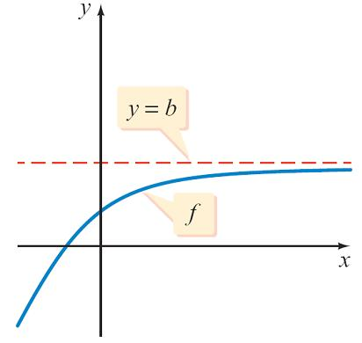
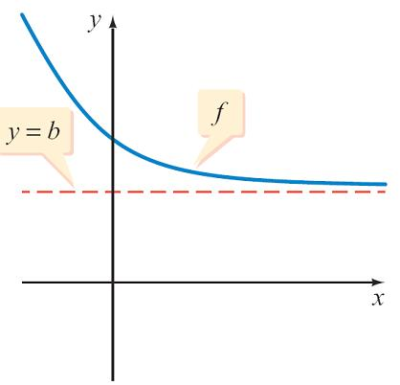
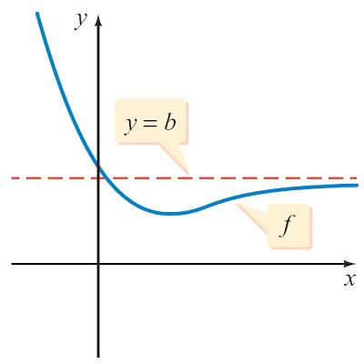
Vertical and Horizontal Asymptotes
The figure below illustrates some of the ways in which the graph of a rational function may approach its horizontal asymptote.
F(x) → b as x →+

Slide 15
It is common practice to display the asymptotes of the graph of a rational function by using dashed lines.
Although a rational function may have several vertical asymptotes, it can have at most one horizontal asymptote.
The graph may intersect its horizontal asymptote.
Geometrically, a line is an asymptote of a curve if the distance between the line and a point P(x, y) on the curve approaches zero as the distance between the origin and the point P increases without bound.

Slide 16
Vertical asymptotes of the graph of a rational function can be found by using the following theorem.
Theorem on Vertical Asymptotes
If the real number a is a zero of the denominator Q(x),
then the graph of F(x) = P(x)/Q(x), where P(x) and Q(x) have no common factors, has the vertical asymptote x = a.

Slide 17
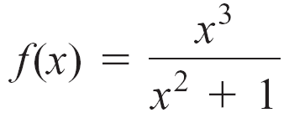
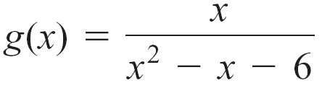
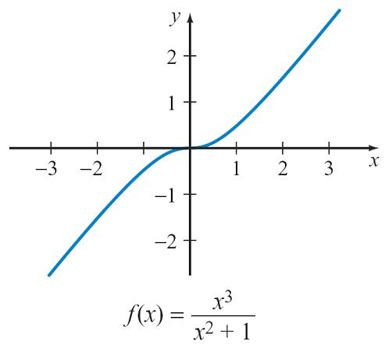
Example 1 – Find the Vertical Asymptotes of a Rational Function
Find the vertical asymptotes of each rational function.
a. b.
Solution:
a. To find the vertical asymptotes, determine the real zeros of the denominator. The denominator x² + 1 has no real zeros, so the graph of f has no vertical asymptotes.

Slide 18
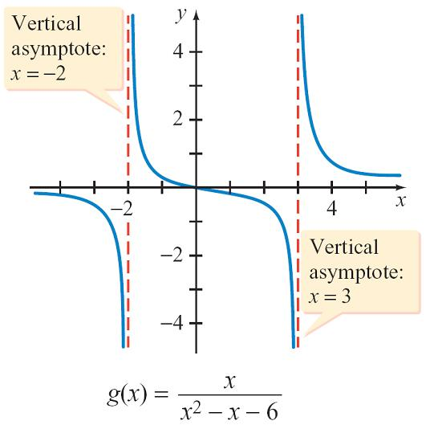
cont’d
b. The denominator x² – x – 6 = (x – 3)(x + 2) has zeros of 3 and –2. The numerator has no common factors with the denominator, so x = 3 and x = –2 are both vertical asymptotes of the graph of g.

Slide 19
Vertical and Horizontal Asymptotes
If the denominator of a rational function is written as a product of linear factors, then the following theorem can be used to determine the manner in which the graph of the rational function approaches its vertical asymptotes.
Behavior Near a Vertical Asymptote Theorem
Let F be a function defined by a rational expression in simplest form.
If (x – a)^{n} is the largest power of (x – a) that is a factor of the denominator of F, then the graph of F will have a vertical asymptote at x = a.

Slide 20
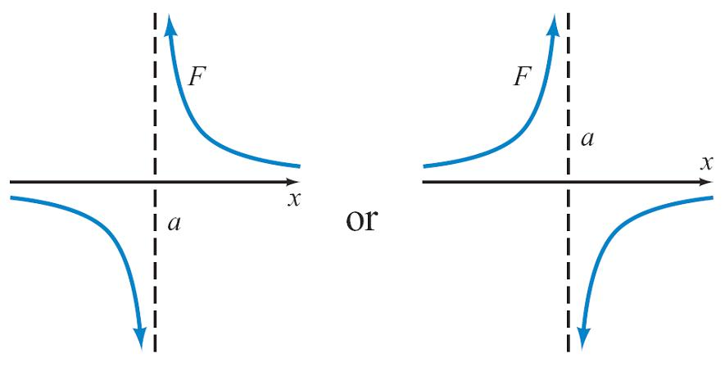
Its graph will approach the asymptote in the manner shown below.
1. If n is odd, F will approach + on one side of the vertical asymptote and on the other side of the vertical asymptote.

Slide 21
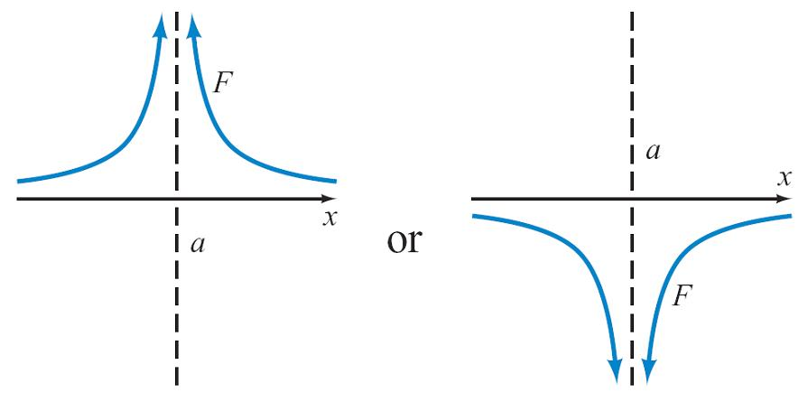
2. If n is even, F will approach + on both sides of the vertical asymptote or F will approach on both sides of the vertical asymptote.

Slide 22
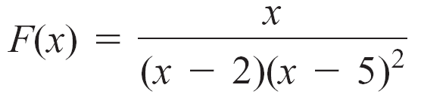
Here is a specific example of how we can use the Behavior Near a Vertical Asymptote Theorem. Consider the rational function
The exponent of (x – 2) is 1. Because 1 is an odd number, the graph of F will approach + on one side of the vertical asymptote x = 2 and it will approach on the other side. The exponent of (x – 5) is 2.

Slide 23
Because 2 is an even number, the graph of F will approach + on both sides of the vertical asymptote x = 5 or it will approach on both sides of x = 5.
We can examine the factors of F to determine the exact manner in which F approaches its vertical asymptotes.
For instance, as x → 2 ⁺, the factor (x – 2) approaches 0 through positive values and the factor (x – 5)² approaches (–3)² = 9 through positive values.

Slide 24
Vertical and Horizontal Asymptotes
Thus, as x → 2 ⁺, the denominator of F approaches 0  9 = 0 through positive values and the numerator of F approaches 2 through positive values.
From this analysis, we see that as x → 2 ⁺ the quotient of x and (x – 2)(x – 5)² will be positive and that it will become larger and larger as x gets closer and closer to 2.
That is, as x → 2 ⁺, F → + .

Slide 25
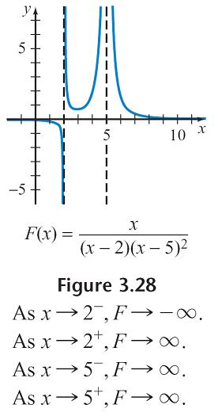
We could use a similar analysis to determine the behavior of F as x → 2 – ; however, we have already determined that F approaches + on one side of x = 2 and on the other side.
Thus we can conclude that as x → 2 –, F → .
See the figure below

Slide 26
As x → 5⁺, the factor (x – 2) approaches 3 through positive values and the factor (x – 5)² approaches (0)² = 0 through positive values.
Thus, as x → 5⁺, the denominator of F approaches 3  0 = 0 through positive values and the numerator of F approaches 5 through positive values.
From this analysis, we see that as x → 5⁺, the quotient of x and (x – 2)(x – 5)² will be positive and that it will become larger and larger as x gets closer and closer to 5.

Slide 27

That is, as x → 5 ⁺, F → + . We have already determined that F approaches + on both sides of x = 5 or F approaches on both sides of x = 5. Thus we can conclude that as x → 5 – , F → + .

Slide 28
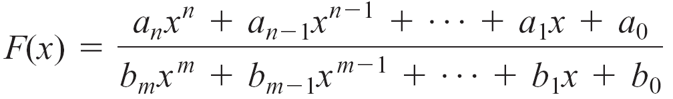
The following theorem indicates that a horizontal asymptote can be determined by examining the leading terms of the numerator and the denominator of a rational function.
Theorem on Horizontal Asymptotes
Let
be a rational function with numerator of degree n and denominator of degree m.

Slide 29
1. If n < m, then the x-axis, which is the line given by y = 0, is the horizontal asymptote of the graph of F.
2. If n = m, then the line given by y = a_{n} /b_{m} is the horizontal asymptote of the graph of F.
3. If n > m, then the graph of F has no horizontal asymptote.

Slide 30
Sign Property of Rational Functions

Slide 31
Sign Property of Rational Functions
The zeros and vertical asymptotes of a rational function F divide the x-axis into intervals.
In each interval, F (x) is positive for all x in the interval or F (x) is negative for all x in the interval.
For example, consider the rational function
which has vertical asymptotes of x = –3 and x = 1 and a zero of –1. These three numbers divide the x-axis into the four intervals ( , –3), (–3, –1), (–1, 1), and (1,+ ).

Slide 32
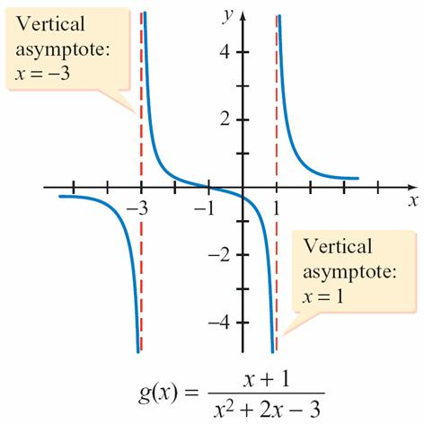
Sign Property of Rational Functions
Note in the figure below that the graph of g is negative for all x such that x < –3, positive for all x such that –3 < x < –1, negative for all x such that –1 < x < 1, and positive for all x such that x > 1.

Slide 33
General Graphing Procedure

Slide 34
General Graphing Procedure
If F(x) = P(x)/Q(x), where P(x) and Q(x) are polynomials that have no common factors, then the following general procedure offers useful guidelines for graphing F.
General Procedure for Graphing Rational Functions That Have No Common Factors
1. Asymptotes: Find the real zeros of the denominator Q(x). For each zero a, draw the dashed line x = a. Each line is a vertical asymptote of the graph of F. Also graph any horizontal asymptotes.

Slide 35
General Graphing Procedure
2. Intercepts: Find the real zeros of the numerator P(x). For each real zero c, plot the point (c, 0). Each such point is an x-intercept of the graph of F. For each x intercept, use the even and odd powers of (x – c) to determine whether the graph crosses the x-axis at the intercept or intersects but does not cross the x-axis. Also evaluate F(0). Plot (0, F(0)), the y-intercept of the graph of F.
3. Symmetry: Use the tests for symmetry to determine whether the graph of the function has symmetry with respect to the y-axis or symmetry with respect to the origin.

Slide 36
General Graphing Procedure
4. Additional points: Plot some points that lie in the intervals between and beyond the vertical asymptotes and the x-intercepts.
5. Behavior near asymptotes: If x = a is a vertical asymptote, determine whether F (x) → or F (x) → as x → a – and as x → a ⁺.
6. Sketch the graph: Use all the information obtained in steps 1 through 5 to sketch the graph of F.

Slide 37
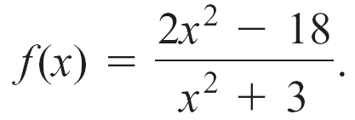
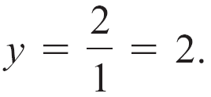
Example 3 – Graph a Rational Function
Sketch a graph of
Solution:
1. Asymptotes: The denominator x² + 3 has no real zeros, so the graph of f has no vertical asymptotes. The numerator and denominator both are of degree 2. The leading coefficients are 2 and 1, respectively. By the Theorem on Horizontal Asymptotes, the graph of f has a
horizontal asymptote of

Slide 38
Example 3 – Solution
cont’d
2. Intercepts: The zeros of the numerator occur when 2x² – 18 = 0 or, solving for x, when x = –3 and x = 3. Therefore, the x-intercepts are (–3, 0) and (3, 0). The factored numerator is 2(x + 3)(x – 3).
Each linear factor has an exponent of 1, an odd number. Thus the graph crosses the x-axis at its x-intercepts.
To find the y-intercept, evaluate f when x = 0. This gives y = –6. Therefore, the y-intercept is (0, –6).

Slide 39

Example 3 – Solution
cont’d
3. Symmetry: Below we show that f (–x) = f (x), which means that f is an even function and therefore its graph is symmetric with respect to the y-axis.

Slide 40
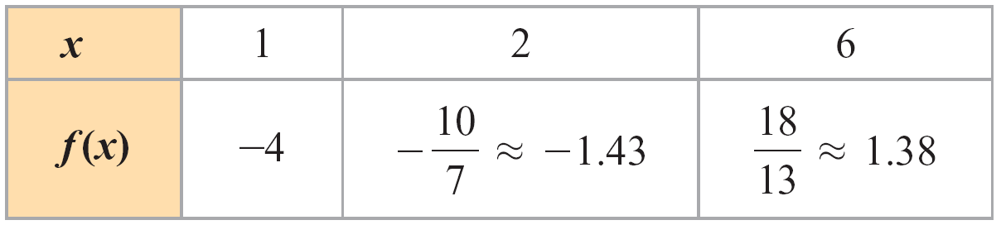
Example 3 – Solution
cont’d
4. Additional points: The intervals determined by the x-intercepts are x < –3, –3 < x < 3, and x > 3. Generally, it is necessary to determine points in all intervals.
However, because f is an even function, its graph is symmetric with respect to the y-axis.
The following table lists a few points for x > 0. Symmetry can be used to locate corresponding points for x < 0.

Slide 41
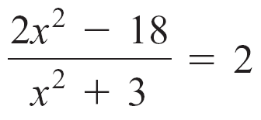
Example 3 – Solution
cont’d
5. Behavior near asymptotes: As x increases or decreases without bound, f (x) approaches the horizontal asymptote y = 2.
To determine whether the graph of f intersects the horizontal asymptote at any point, solve the equation f (x) = 2. There are no solutions of f (x) = 2 because
implies 2x² – 18 = 2x² + 6 implies –18 = 6
This is not possible.

Slide 42
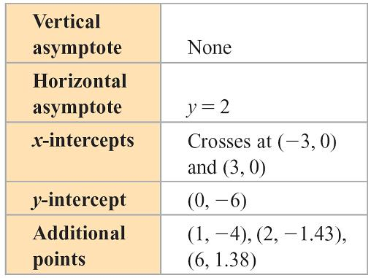
Example 3 – Solution
cont’d
Thus the graph of f does not intersect the horizontal asymptote but approaches it from below as x increases or decreases without bound.
6. Sketch the graph: Use the summary in the table below to sketch the graph.

Slide 43
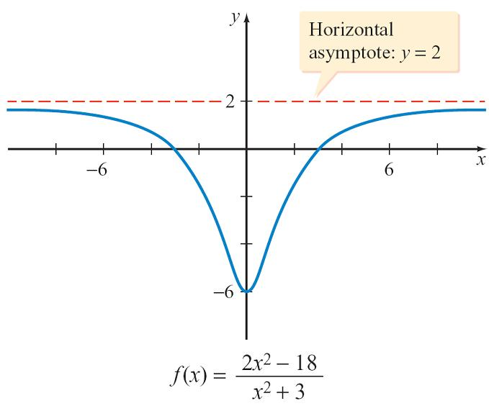
Example 3 – Solution
cont’d
The completed graph is shown below.

Slide 44
Slant Asymptotes

Slide 45
Slant Asymptotes
Some rational functions have an asymptote that is neither vertical nor horizontal but slanted.
Definition of a Slant Asymptote
The line given by y = mx + b, m ≠ 0, is a slant asymptote of the graph of a function F provided F(x) mx + b as x + or x .

Slide 46
Slant Asymptotes
The following theorem can be used to determine which rational functions have a slant asymptote.
Theorem on Slant Asymptotes
The rational function given by F(x) = P(x)/Q(x), where P(x) and Q(x) have no common factors, has a slant asymptote if the degree of P(x) is one greater than the degree of Q(x).
To find the slant asymptote, divide P(x) by Q(x) and write F(x) in the form

Slide 47
Slant Asymptotes
where the degree of r(x) is less than the degree of Q(x). Because
as
we know that as F(x) mx + b as .
The line represented by y = mx + b is the slant asymptote of the graph of F.

Slide 48
Example 5 – Find the Slant Asymptote of a Rational Function
Find the slant asymptote of
Solution:
Because the degree of the numerator 2x³ + 5x² + 1 is exactly one larger than the degree of the denominator x² + x + 3 and f is in simplest form, f has a slant asymptote.
To find the asymptote, divide 2x³ + 5x² + 1 by x² + x + 3.

Slide 49
Example 5 – Solution
cont’d
Therefore,

Slide 50
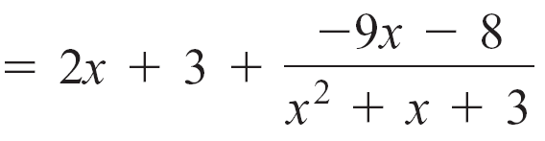
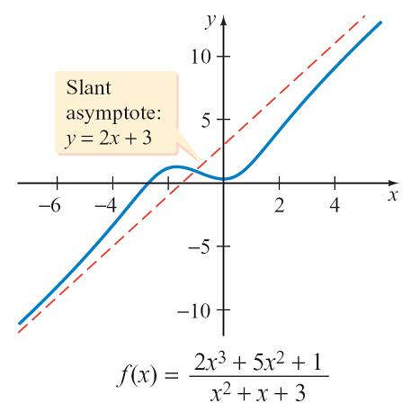
Example 5 – Solution
cont’d
and the line given by y = 2x + 3 is the slant asymptote for the graph of f.
The figure shows the graph of f and its slant asymptote.

Slide 51
Slant Asymptotes
The function f in Example 5 does not have a vertical asymptote because the denominator x² + x + 3 does not have any real zeros. However, the function
has both a slant asymptote and a vertical asymptote.
The vertical asymptote is x = 3, and the slant asymptote is y = –2x – 2.

Slide 52
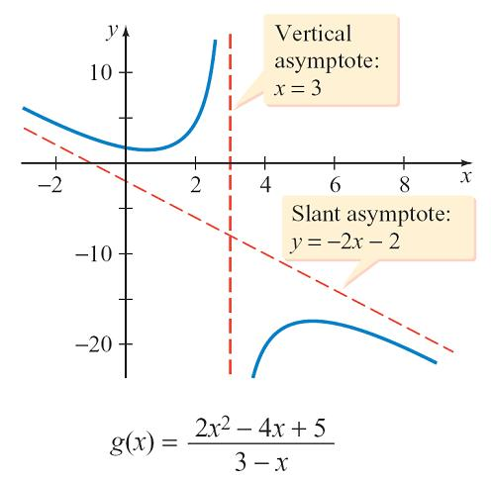
Slant Asymptotes
The figure shows the graph of g and its asymptotes.

Slide 53
Graphing Rational Functions That Have a Common Factor

Slide 54
Graphing Rational Functions That Have a Common Factor
If a rational function has a numerator and denominator that have a common factor, then you should reduce the rational function to simplest form before you apply the general procedure for sketching the graph of a rational function.

Slide 55


Example 6 – Graph a Rational Function That Has a Common Factor
Sketch the graph of
Solution:
Factor the numerator and denominator to obtain
Thus for all x values other than x = 4, the graph of f is the same as the graph of

Slide 56
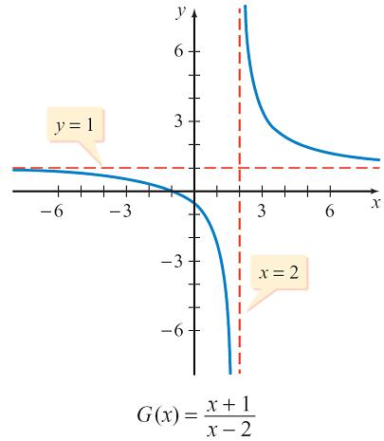
Example 6 – Solution
cont’d
The figure shows a graph of G.
The graph of f will be the same as this graph, except that it will have an open circle at (4, 2.5) to indicate that it is undefined at x = 4.

Slide 57
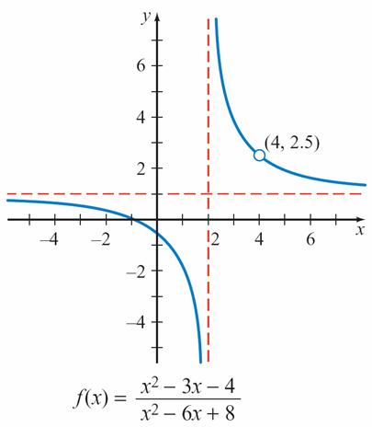
Example 6 – Solution
cont’d
See the graph of f in the figure.
The height of the open circle was found by evaluating the resulting reduced rational function
at x = 4.

Slide 58
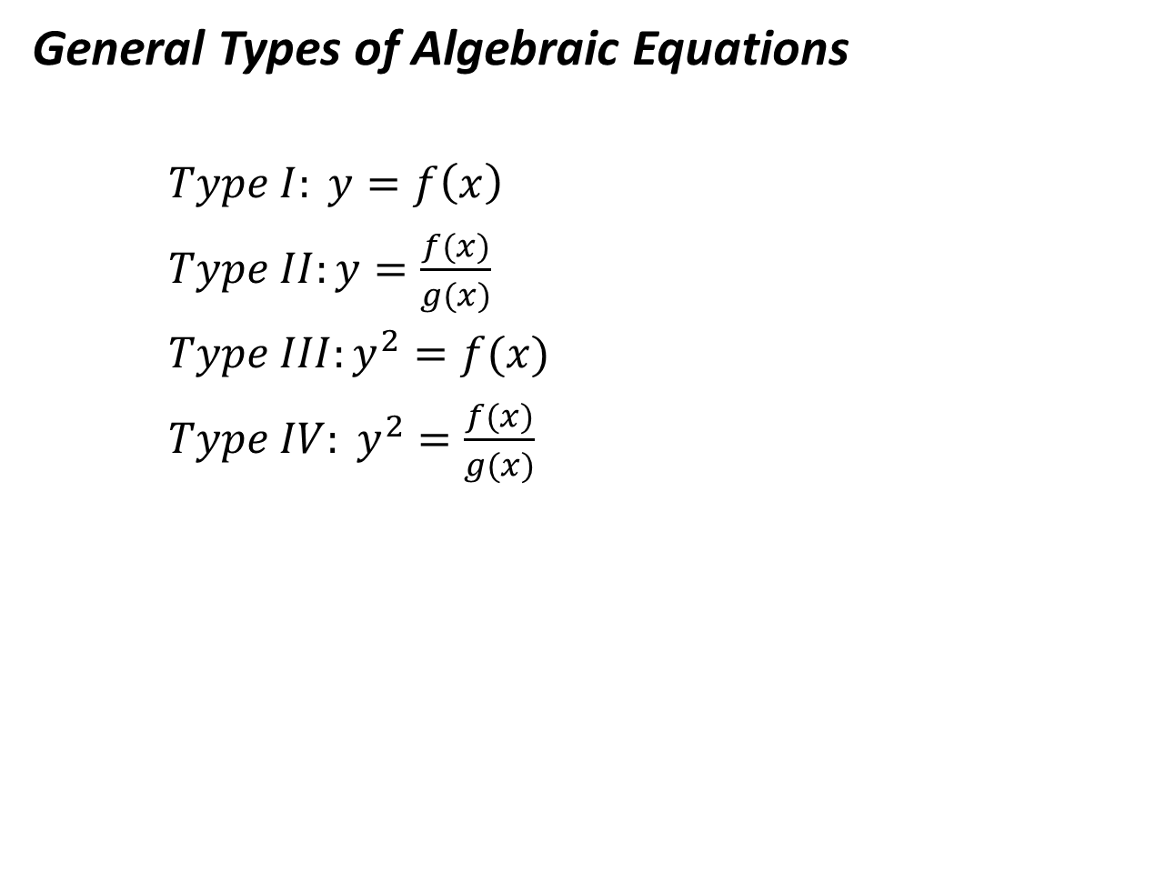

Slide 59
